Slide 1
Experiment in
Compiler Construction
Parser design
Nguyen Huu Duc
Department of information systems
Faculty of information technology
Hanoi university of technology
Experiment in compiler construction – Parser design

Slide 2
Content
Overview
KPL grammar
Parser implementation
Experiment in compiler construction – Parser design

Slide 3
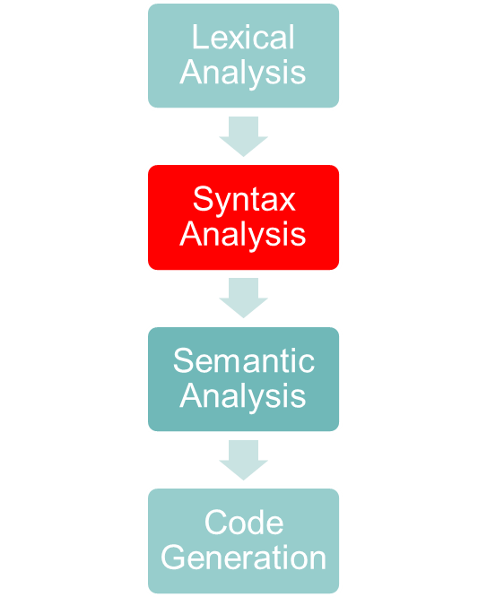
Tasks of a parser
Check the syntactic structure of a given program
  Syntactic structure is given by Grammar
Invoke semantic analysis and code generation
  In an one-pass compiler, this module is very important since this forms the skeleton of the compiler
Experiment in compiler construction - Parser design

Slide 4
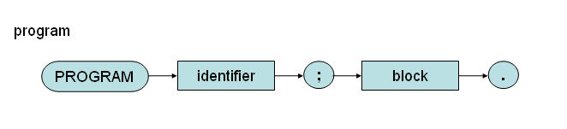
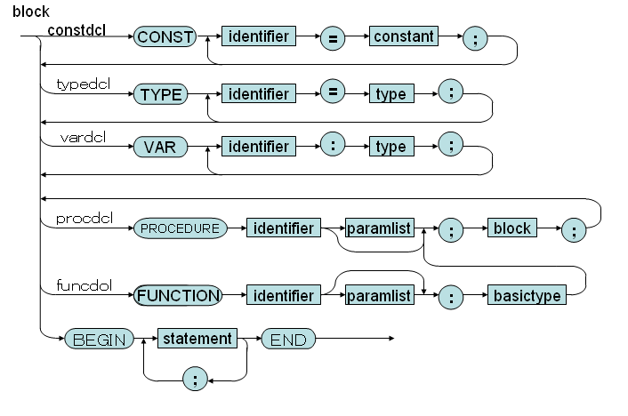
Syntax diagram of KPL
Experiment in compiler construction - Intermediate Code Generation

Slide 5
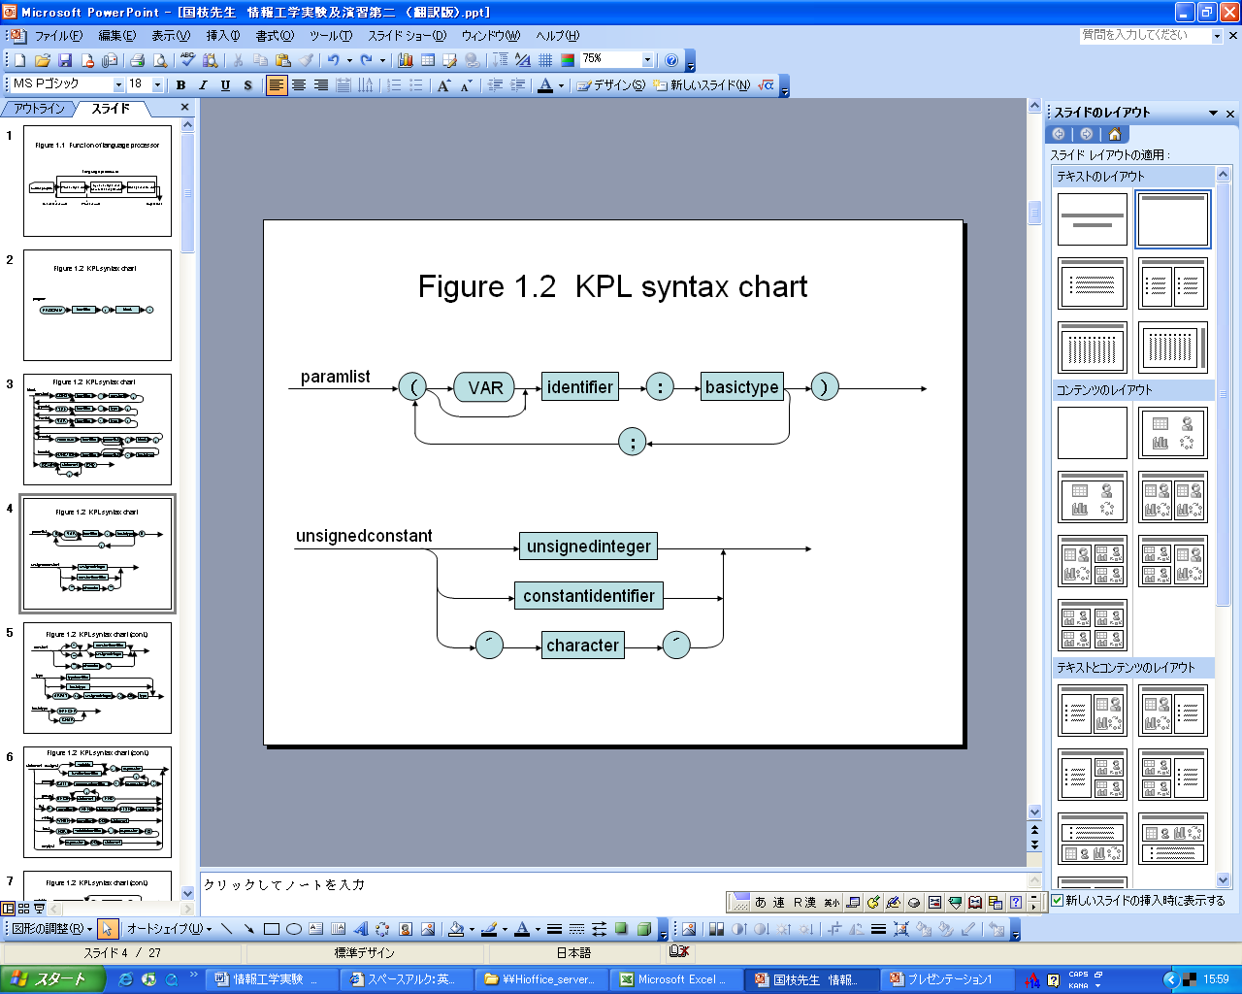
Syntax diagram of KPL
Experiment in compiler construction - Parser design

Slide 6
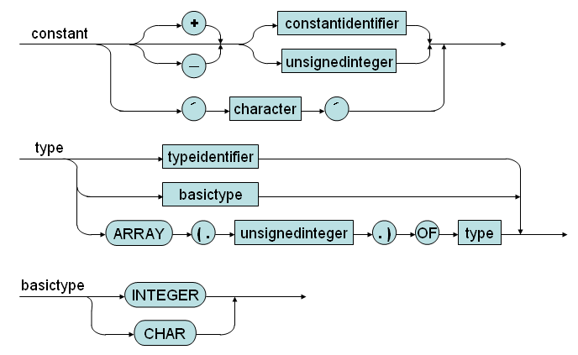
Syntax diagram of KPL
Experiment in compiler construction - Parser design

Slide 7
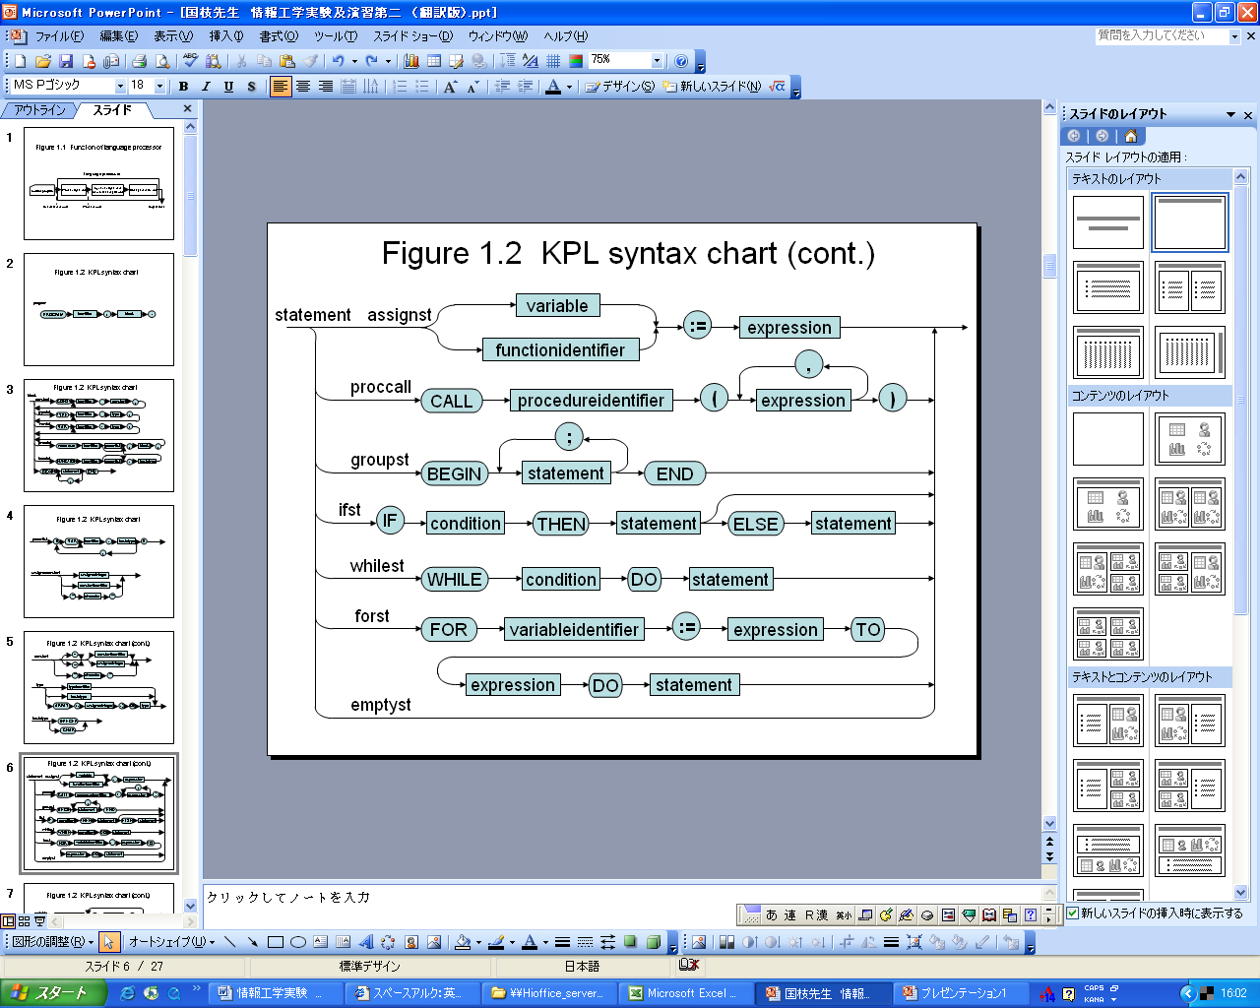
Syntax diagram of KPL
Experiment in compiler construction - Parser design

Slide 8
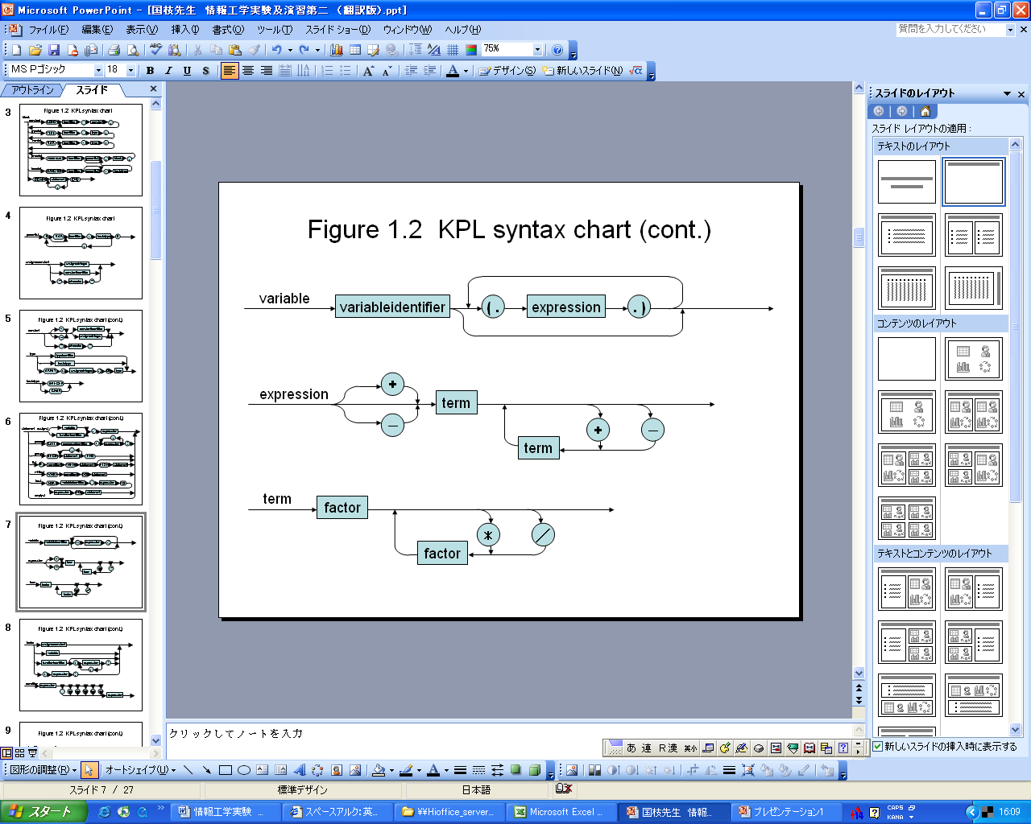
Syntax diagram of KPL
Experiment in compiler construction - Parser design

Slide 9
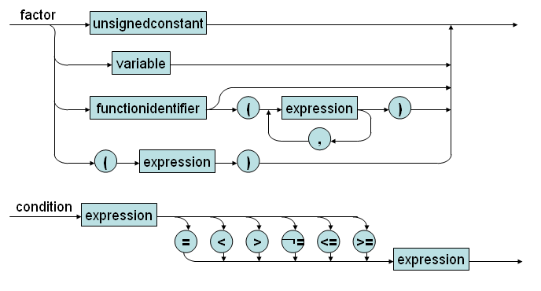
Syntax diagram of KPL
Experiment in compiler construction - Parser design

Slide 10
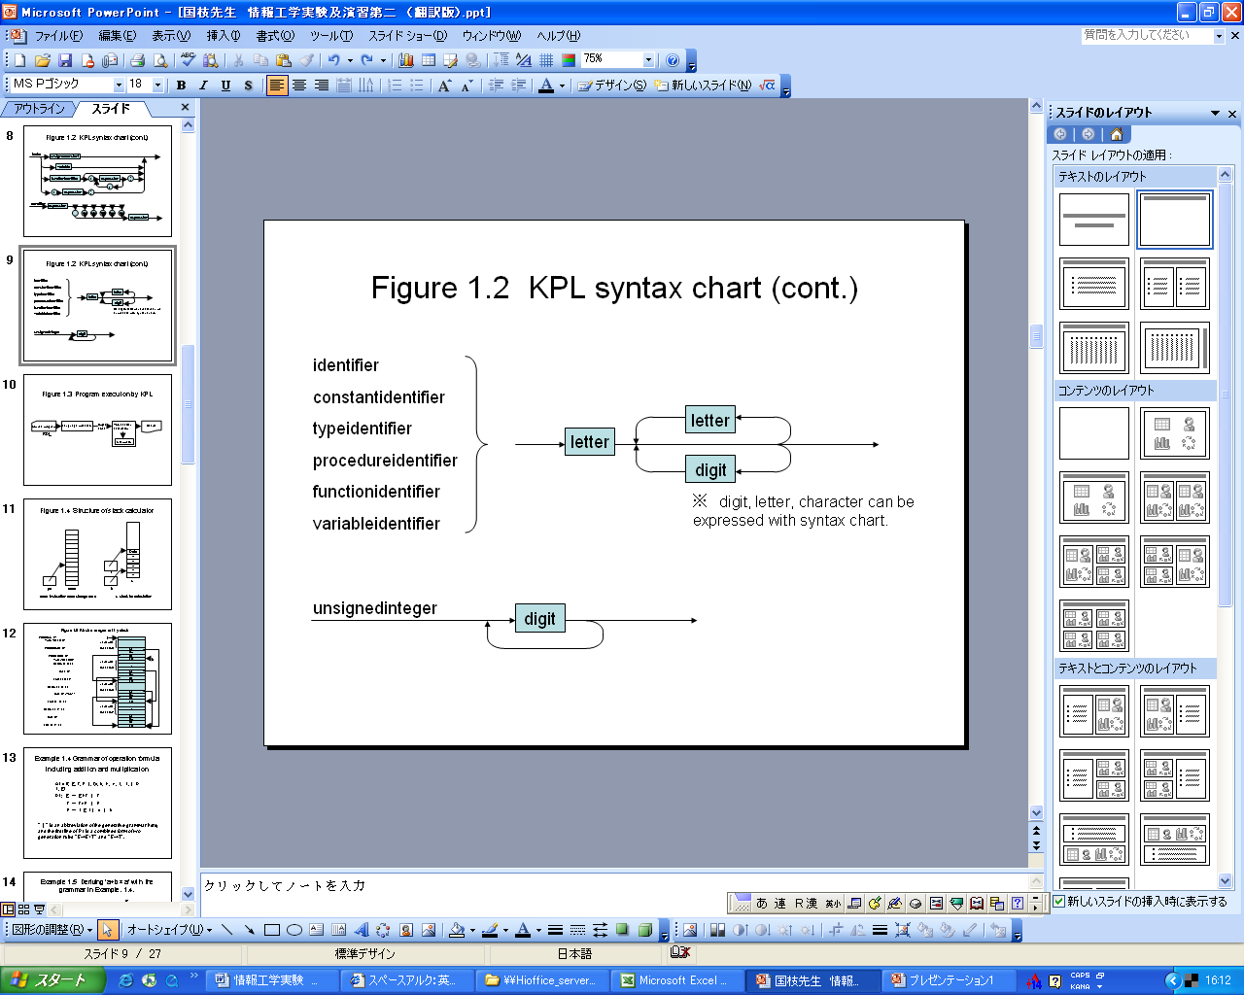
Syntax diagram of KPL
Experiment in compiler construction - Parser design

Slide 11
KPL Grammar in BNF
Construct a grammar G based on syntax diagram
Perform left recursive elimination (already)
Perform left factoring
Experiment in compiler construction – Parser design

Slide 12
KPL Grammar in BNF
01) Prog ::= KW_PROGRAM TK_IDENT SB_SEMICOLON Block SB_PERIOD
02) Block ::= KW_CONST ConstDecl ConstDecls Block2
03) Block ::= Block2
04) Block2 ::= KW_TYPE TypeDecl TypeDecls Block3
05) Block2 ::= Block3
06) Block3 ::= KW_VAR VarDecl VarDecls Block4
07) Block3 ::= Block4
08) Block4 ::= SubDecls Block5
09) Block5 ::= KW_BEGIN Statements KW_END
Experiment in compiler construction – Parser design

Slide 13
KPL Grammar in BNF
10) ConstDecls::= ConstDecl ConstDecls
11) ConstDecls::= ε
12) ConstDecl ::= TK_IDENT SB_EQUAL Constant SB_SEMICOLON
13) TypeDecls ::= TypeDecl TypeDecls
14) TypeDecls ::= ε
15) TypeDecl ::= TK_IDENT SB_EQUAL Type SB_SEMICOLON
16) VarDecls ::= VarDecl VarDecls
17) VarDecls ::= ε
18) VarDecl ::= TK_IDENT SB_COLON Type SB_SEMICOLON
19) SubDecls ::= FunDecl SubDecls
20) SubDecls ::= ProcDecl SubDecls
21) SubDecls ::= ε
Experiment in compiler construction – Parser design

Slide 14
KPL Grammar in BNF
22) FunDecl ::= KW_FUNCTION TK_IDENT Params SB_COLON BasicType
SB_SEMICOLON Block SB_SEMICOLON
23) ProcDecl ::= KW_PROCEDURE TK_IDENT Params SB_SEMICOLON Block
SB_SEMICOLON
24) Params ::= SB_LPAR Param Params2 SB_RPAR
25) Params ::= ε
26) Params2 ::= SB_SEMICOLON Param Params2
27) Params2 ::= ε
28) Param ::= TK_IDENT SB_COLON BasicType
29) Param ::= KW_VAR TK_IDENT SB_COLON BasicType
Experiment in compiler construction – Parser design

Slide 15
KPL Grammar in BNF
30) Type ::= KW_INTEGER
31) Type ::= KW_CHAR
32) Type ::= TK_IDENT
33) Type ::= KW_ARRAY SB_LSEL TK_NUMBER SB_RSEL KW_OF Type
34) BasicType ::= KW_INTEGER
35) BasicType ::= KW_CHAR
36) UnsignedConstant ::= TK_NUMBER
37) UnsignedConstant ::= TK_IDENT
38) UnsignedConstant ::= TK_CHAR
40) Constant ::= SB_PLUS Constant2
41) Constant ::= SB_MINUS Constant2
42) Constant ::= Constant2
43) Constant ::= TK_CHAR
44) Constant2::= TK_IDENT
45) Constant2::= TK_NUMBER
Experiment in compiler construction – Parser design

Slide 16
KPL Grammar in BNF
46) Statements ::= Statement Statements2
47) Statements2 ::= KW_SEMICOLON Statement Statements2
48) Statements2 ::= ε
49) Statement ::= AssignSt
50) Statement ::= CallSt
51) Statement ::= GroupSt
52) Statement ::= IfSt
53) Statement ::= WhileSt
54) Statement ::= ForSt
55) Statement ::= ε
Experiment in compiler construction – Parser design

Slide 17
KPL Grammar in BNF
56) AssignSt ::= Variable SB_ASSIGN Expession
57) CallSt ::= KW_CALL ProcedureIdent Arguments
58) GroupSt ::= KW_BEGIN Statements KW_END
59) IfSt ::= KW_IF Condition KW_THEN Statement ElseSt
60) ElseSt ::= KW_ELSE Statement
61) ElseSt ::= ε
62) WhileSt ::= KW_WHILE Condition KW_DO Statement
63) ForSt ::= KW_FOR TK_IDENT SB_ASSIGN Expression
KW_TO Expression KW_DO Statement
Experiment in compiler construction – Parser design

Slide 18
KPL Grammar in BNF
64) Arguments ::= SB_LPAR Expression Arguments2 SB_RPAR
65) Arguments ::= ε
66) Arguments2::= SB_COMMA Expression Arguments2
67) Arguments2::= ε
68) Condition ::= Expression Condition2
69) Condition2::= SB_EQ Expression
70) Condition2::= SB_NEQ Expression
71) Condition2::= SB_LE Expression
72) Condition2::= SB_LT Expression
73) Condition2::= SB_GE Expression
74) Condition2::= SB_GT Expression
Experiment in compiler construction – Parser design

Slide 19
KPL Grammar in BNF
75) Expression ::= SB_PLUS Expression2
76) Expression ::= SB_MINUS Expression2
77) Expression ::= Expression2
78) Expression2 ::= Term Expression3
79) Expression3 ::= SB_PLUS Term Expression3
80) Expression3 ::= SB_MINUS Term Expression3
81) Expression3 ::= ε
82) Term ::= Factor Term2
83) Term2 ::= SB_TIMES Factor Term2
84) Term2 ::= SB_SLASH Factor Term2
85) Term2 ::= ε
Experiment in compiler construction – Parser design

Slide 20
KPL Grammar in BNF
86) Factor ::= TK_NUMBER
87) Factor ::= TK_CHAR
88) Factor ::= TK_IDENT Indexes
89) Factor ::= TK_IDENT Arguments
90) Factor ::= SB_LPAR Expression SB_RPAR
91) Variable ::= TK_IDENT Indexes
92) FunctionApplication ::= TK_IDENT Arguments
93) Indexes ::= SB_LSEL Expression SB_RSEL Indexes
94) Indexes ::= ε
Experiment in compiler construction – Parser design

Slide 21
Implemetation
KPL is a LL(1) language
design a top-down parser
  lookAhead token
  Parsing terminals
  Parsing non-terminals
    Constructing a parsing table
      Computing FIRST() and FOLLOW()
Experiment in compiler construction – Parser design

Slide 22
lookAhead token
Look ahead the next token
Token *currentToken; // Token vừa đọc
Token *lookAhead; // Token xem trước
void scan(void) {
Token* tmp = currentToken;
currentToken = lookAhead;
lookAhead = getValidToken();
free(tmp);
}
Experiment in compiler construction – Parser design

Slide 23
Parsing terminal symbol
void eat(TokenType tokenType) {
if (lookAhead->tokenType == tokenType) {
printToken(lookAhead);
scan();
} else
missingToken(tokenType, lookAhead->lineNo, lookAhead->colNo);
}
Experiment in compiler construction – Parser design

Slide 24
Invoking parser
int compile(char *fileName) {
if (openInputStream(fileName) == IO_ERROR)
return IO_ERROR;
currentToken = NULL;
lookAhead = getValidToken();
compileProgram();
free(currentToken);
free(lookAhead);
closeInputStream();
return IO_SUCCESS;
}
Experiment in compiler construction – Parser design

Slide 25
Parsing non-terminal symbol
Example: Program
void compileProgram(void) {
assert("Parsing a Program ....");
eat(KW_PROGRAM);
eat(TK_IDENT);
eat(SB_SEMICOLON);
compileBlock();
eat(SB_PERIOD);
assert("Program parsed!");
}
Experiment in compiler construction – Parser design

Slide 26
Parsing non-terminal symbol
Example: Statement
FIRST(Statement) = {TK_IDENT, KW_CALL, KW_BEGIN, KW_IF, KW_WHILE,
KW_FOR, ε}
FOLLOW(Statement) = {SB_SEMICOLON, KW_END, KW_ELSE}
/* Predict parse table for Expression */
Input Production
----------------------------------------------------
TK_IDENT 49) Statement ::= AssignSt
KW_CALL 50) Statement ::= CallSt
KW_BEGIN 51) Statement ::= GroupSt
KW_IF 52) Statement ::= IfSt
KW_WHILE 53) Statement ::= WhileSt
KW_FOR 54) Statement ::= ForSt
----------------------------------------------------
SB_SEMICOLON 55) ε
KW_END 55) ε
KW_ELSE 55) ε
----------------------------------------------------
Others Error
Experiment in compiler construction – Parser design

Slide 27
Parsing non-terminal symbol
Example: Statement
void compileStatement(void) {
switch (lookAhead->tokenType) {
case TK_IDENT:
compileAssignSt();
break;
case KW_CALL:
compileCallSt();
break;
case KW_BEGIN:
compileGroupSt();
break;
case KW_IF:
compileIfSt();
break;
case KW_WHILE:
compileWhileSt();
break;
case KW_FOR:
compileForSt();
break;
// check FOLLOW tokens
case SB_SEMICOLON:
case KW_END:
case KW_ELSE:
break;
// Error occurs
default:
error(ERR_INVALIDSTATEMENT, lookAhead->lineNo, lookAhead->colNo);
break;
}
}
Experiment in compiler construction – Parser design

Slide 28
Assignment 1
Parsing a program containing
  Constant declaration
  Type declaration
  Variable declaration
  Empty block
Experiment in compiler construction – Parser design

Slide 29
Assignment 2
Parsing a program containing
  Constant declaration
  Type declaration
  Variable declaration
  Statements
Experiment in compiler construction – Parser design

Slide 30
Assignment 3
Parsing a program with full flegde grammar
Experiment in compiler construction – Parser design

Slide 31
Branch processing
34) BasicType ::= KW_INTEGER
35) BasicType ::= KW_CHAR
void compileBasicType(void) {
switch (lookAhead->tokenType) {
case KW_INTEGER:
eat(KW_INTEGER);
break;
case KW_CHAR:
eat(KW_CHAR);
break;
default:
error(ERR_INVALIDBASICTYPE, lookAhead->lineNo, lookAhead->colNo);
break;
}
}
Experiment in compiler construction – Semantic Analysis

Slide 32
Loop processing
10) ConstDecls::= ConstDecl ConstDecls
11) ConstDecls::= ε
void compileConstDecls(void) {
while (lookAhead->tokenType == TK_IDENT)
compileConstDecl();
}
Experiment in compiler construction – Semantic Analysis

Slide 33
Loop processing
67) Arguments2::= SB_COMMA Expression Arguments2
68) Arguments2::= ε
void compileArguments2(void) {
switch (lookAhead->tokenType) {
case SB_COMMA:
eat(SB_COMMA);
compileExpression();
compileArguments2();
break;
// check the FOLLOW set
case SB_RPAR:
break;
default:
error(ERR_INVALIDARGUMENTS, lookAhead->lineNo, lookAhead->colNo);
}
}
Experiment in compiler construction – Semantic Analysis

